Slide 1

new Restaurant recomendation system
Visakhapatnam

Slide 2
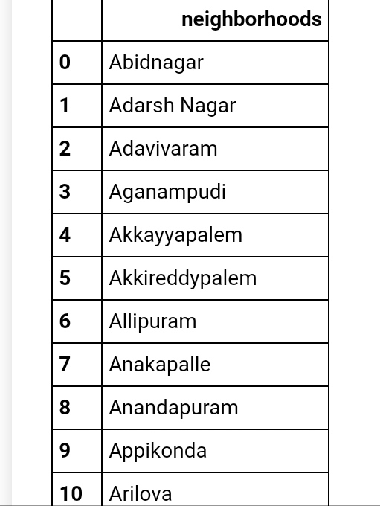
Dataset consisting Visakhapatnam Neighbourhoods
Aim
The main aim of this recommendation is to suggest the best place in order to began a new restaurant in Visakhapatnam.
For this we need some of the major information regarding the venues in Visakhapatnam Nearby

Slide 3
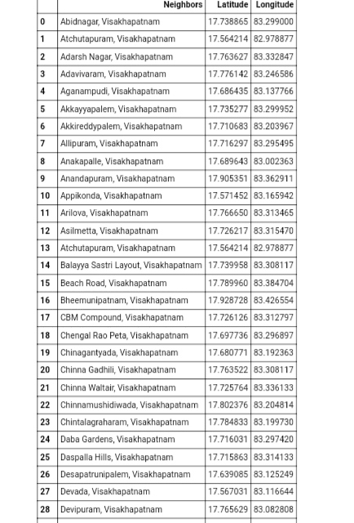
Dataset consisting of the Location
Requirements
The major requirements are as following :
1. Dataset consisting of neighbourhoods of the Visakhapatnam city
2. Even you need have the geographical location of the neighbourhoods in Visakhapatnam

Slide 4
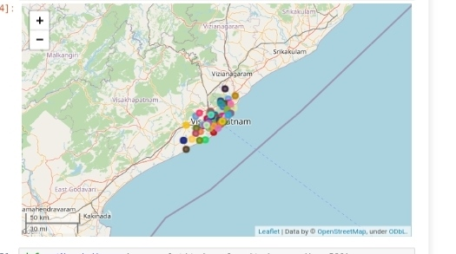
Various types of the venues
Obtaining the nearby venues in Visakhapatnam
This entire process is done using the four square API.
The Foursquare API is where we can get the nearby venues of any specific neighbourhood.
Even using the Foursquare API the various categories of the venues are obtained and these can be grouped by and even sorted.

Slide 5
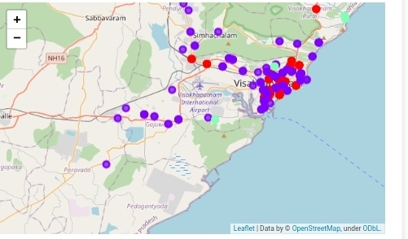
Classification after clustering
Clustering
Before the clustering we are just filtering only the Indian restaurants in nearby venues since we are searching the new location for the restaurant.
The cluster is nothing but the separation of the category restaurant into three types of clusters
Namely :
1. cluster0
2. cluster1
3. cluster2

Slide 6
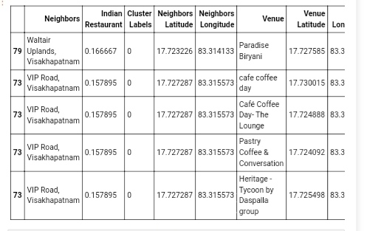
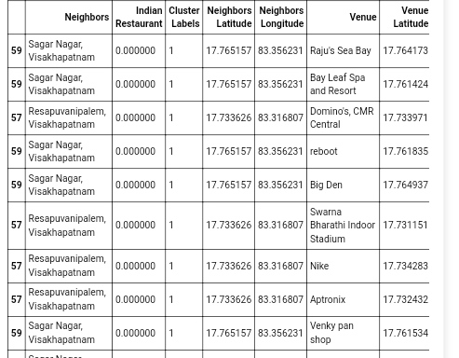
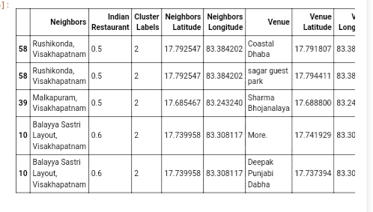
clusters

Slide 7
cluster1
Finally Report
Based on the final report the clustering is classified into 3 categories.
While observing the cluster we can see that the clustering is done on the basis of the mean which is the average of the number of nearby venues.
On the basis of the mean the cluster1 is having very less mean.
So ,I suggest that the cluster1 is good for new restaurant location.
Maddilipalem ,Visakhapatnam is good because it has no Restaurants nearby in range, if its NH16 the location is more identical also.

Slide 8
Thank you for watching
This is the simple way to choose the new location

